Slide 1
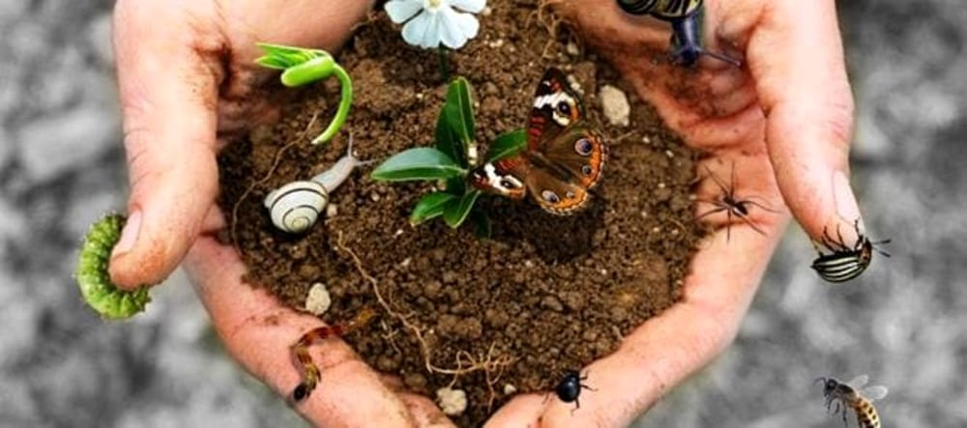
A “KAMISHIBAI”
TO DISCOVER BIODIVERSITY

Slide 2

What are we going to care for?
Biodiversity is a value that we have to know and to defend, because our lifestyles, pollution and climate changes are affecting it.
In that itinerary we will find together why biodiversity influences not just ecosystems but also on our productive and economic structures, and moreover it determines the astonishing beauty and variety of the natural world.
Our task will be to tell other students that topic, even thinking about the special background in which we live (our wonderful Alps!)
Next year we’ll present our work to an urban school class!!

Slide 3

What will we learn?
We will come to know the topic of biodiversity in an active way: you will search the information on the web and then organize and present them to your schoolmates.
We will learn an original way to tell stories, the “Kamishibai”: you will search for examples and models and then realize your own “figures”.
You will be called to put yourself out there and to contribute actively in the activity: it will be a real team play, in which some of you will deal with the scientific side of the matter, others will write the “screenplay” and others will care about the artistic part.

Slide 4
The work phases
The first step will see you concerned in the search of information: someone will study the different sides of biodiversity, others will concentrate on kamishibai theatre, searching for examples and techniques to realize the illustrations. You will bring to school your computers or devices to consult the digital sources.
On the second step you will work on the project: you have to organize and share your ideas and then create a short story dealing with biodiversity.
On the last step you will realize our kamishibai: you will create the illustrations and then prepare and record an animated reading. You could also add a document to accompany and to explain your creative product.

Slide 5

Kamishibai...
What is it???

Slide 6
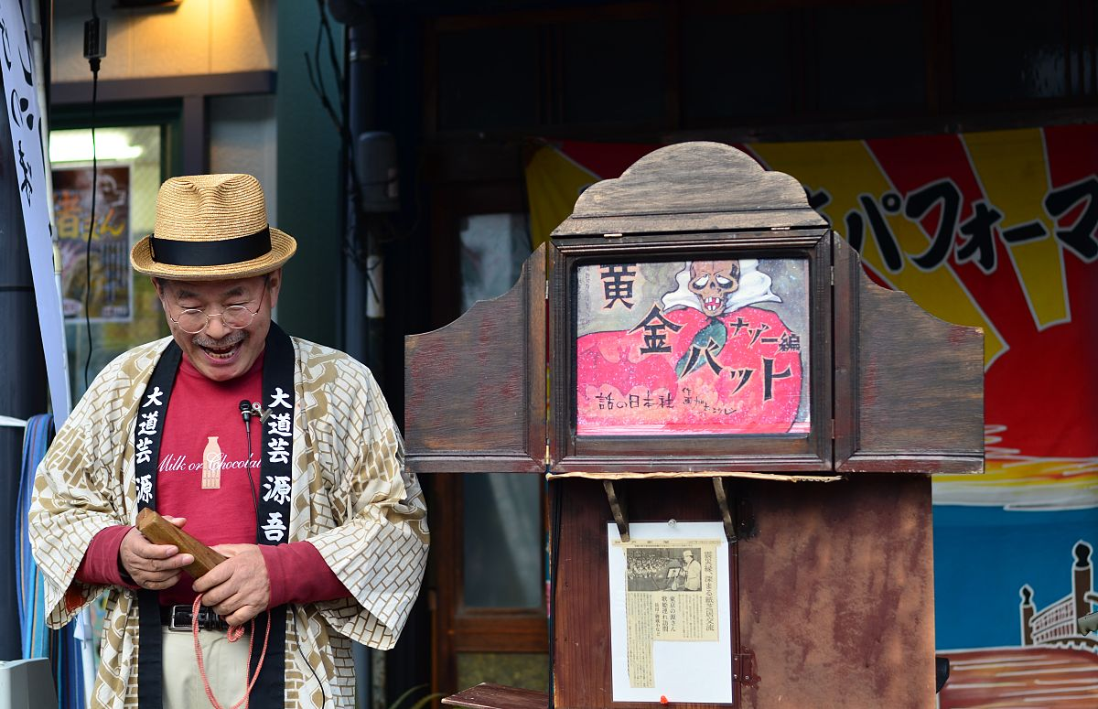
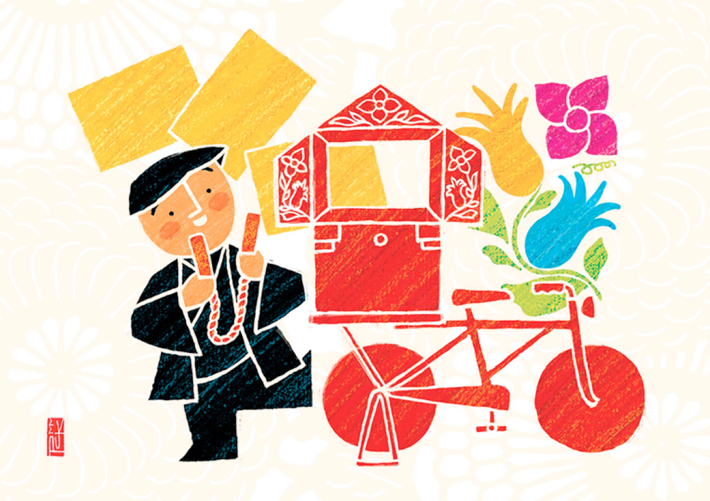
A paper...theatre!
Kamishibai, in Japanese, means “paper theatre” and it is a technique of storytelling very popular in Japan during the ‘20s and the ‘30s.
There were portable theatres, made of wood or cardboard, that were used by the “kamishibaia”, wandering storytellers that moved from one village to another one using their bicycles.

Slide 7
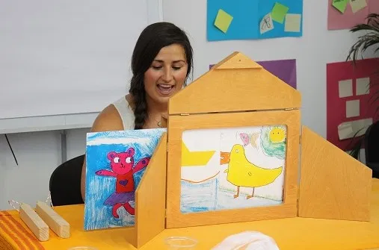
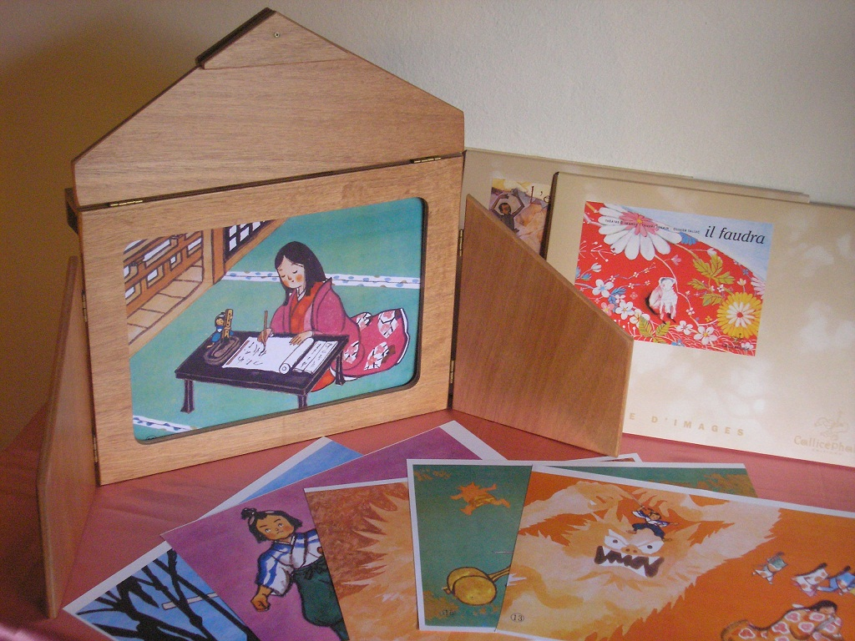
Why paper?
The kamishibaia told their stories with the help of illustrations, that they inserted and extracted from the theatre: thus, children and kids could follow the narration with the help of images.

Slide 8
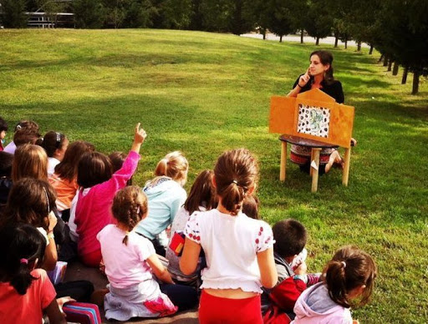
An alternative to video!
The kamishibai, unfortunately, has been replaced by the television, but it is a narrative technique extremely fascinating, that is interesting to bring in schools and artistic workshops: it’s an instrument that allows to exerce narrative thinking and to experiment illustrating methods.

Slide 9

and now it’s up to you...
Start with the first step: you will be divided in two groups.
Some will made a research on kamishibai’s language and the different kinds of illustrations.
Others will deal with the scientific topic, searching infos about biodiversity, even referring to our alpine reality.
You will find useful links to collect infos in the next slides.
You will organize ideas and inspirations in a google presentation. To help you, the teacher will give you a list of questions.
This work will last for two time modules, and then you will share of the results (one time module).
Later you will carry on with the next phases…

Slide 10
Let’s read up...the kamishibai
A French video that explains characteristics of the kamishibai
https://www.youtube.com/watch?v=xIHdS4MzvAE&feature=emb_title
Some digital or paper models, for kids of different ages (some from middle schools in Valle d’Aosta):
https://www.dulala.fr/kamishibais-numeriques/
https://kamilala.org/wp-content/uploads/2020/09/NAT-ET-SON-VOYAGE.pdf
https://kamilala.org/wp-content/uploads/2019/05/kamishibai-c3-kam14.pdf
https://kamilala.org/wp-content/uploads/2020/08/Vall%C3%A9e-dAoste-Il-y-a-une-paire-de-scarpette-rosse.pdf
https://kamilala.org/wp-content/uploads/2020/07/kamishibais-2020-c3-concert-denfer-hep-vaud.pdf
https://kamilala.org/wp-content/uploads/2020/07/kamishibais-2020-c3-petit-singe-hep-vaud.pdf
A page with videos of performing kamishibai:
https://www.greenme.it/vivere/speciale-bambini/kamishibai

Slide 11
And what about biodiversity?
General informations to study the topic:
https://www.wwf.it/il_pianeta/biodiversita/che_cosa_e_biodiversita/
https://www.fondazioneslowfood.com/it/i-nostri-temi/biodiversita/
A slowfood video to explain the importance of biodiversity:
https://www.youtube.com/watch?v=pjqJ37SmZeo&feature=emb_logo
On “Red lists”:
http://www.iucn.it/liste-rosse-italiane.php
In our “home”, the Alps of Valle d’Aosta:
http://www.pngp.it/
https://www.montavic.it/
http://osservatoriobiodiversita.regione.vda.it/Osservatorio_Biodiversita/page1.do?sp=page2
https://www.regione.vda.it/territorio/ambiente/Biodiversita_e_aree_naturali_protette/Aree_naturali_protette/Riserve_naturali/default_i.aspx

Slide 12
Evaluation: on which aspects do you have to concentrate?
Responsibility and participation
Work in group in a collaborative way
Richness and clearness of the content
Realization of the creative product: it must be accurate, imaginative and original

